Slide 1
3D Image Segmentation and Quantification of Lysosomes
4/12/2025

Slide 2
LAST MEETING
My progress these last few weeks:
Checked the size.
Included additional metrics such as mean and standard deviation.
Comparison MANUAL.vs.AUTOMATIC.
Now the script can assign serial order numbers to lysosome and cell IDs.
Review possible over-detection in some images.
I am working in the automatization of same parameters to avoid or reduce over deteccion on all images.
Verify cases where there are lysosomes outside with a different cell ID.
I will start working on this point next week.
OREN: One addition/clarification - need to find a way to limit cell size to a certain (lower) limit so to exclude these fragments being counted as a cell…

Slide 3
FILES
Airy scan_40A_UAS-TMEM-HA_CB_0h_1_051222
Airy scan_40A_UAS-TMEM-HA_CB_0h_2_051222
Airy scan_40A_UAS-TMEM-HA_CB_4h_1_051222
Airy scan_40A_UAS-TMEM-HA_CB_4h_2_051222
TMEM-HA 6h CB airy_3_170722
40A_UAS-TMEM192-3xHA x 40A 71G10 MARCM_around 12h - for quantification_4 Airy-CBs_300425
40A_UAS-TMEM192-3xHA x 40A 71G10 MARCM_around 12h - for quantification_3 Airy-CBs_300425
40A_UAS-TMEM1923x-HA x 71G10 40A MARCM_L3_2_Airy_010724
40A_UAS-TMEM1923x-HA x 71G10 40A MARCM_L3_1_Airy_010724

Slide 4
40A_UAS-TMEM1923x-HA x 71G10 40A MARCM_L3_1_Airy_010724

Slide 5
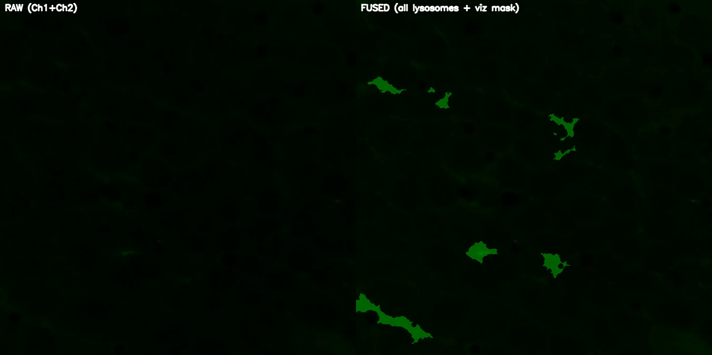
DETECTION VIDEO

Slide 6
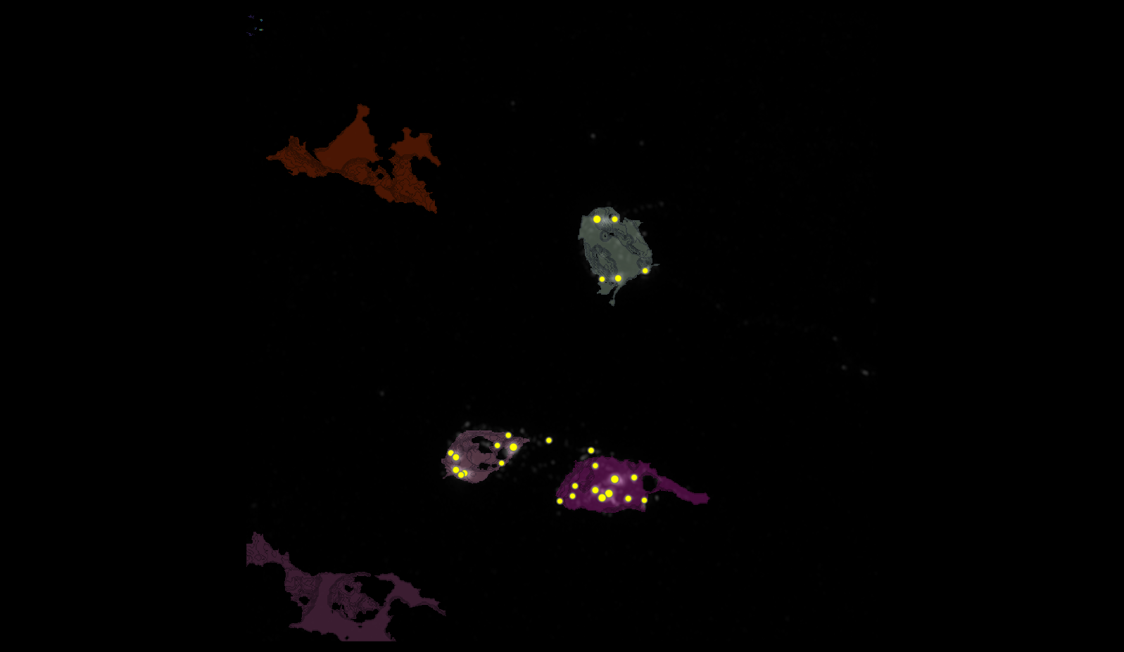
SEGMENTATION
2
3
4

Slide 7
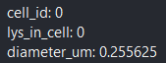
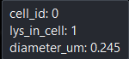
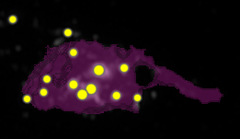
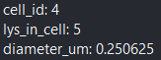
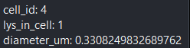
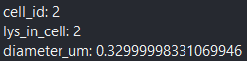
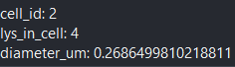
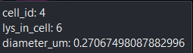
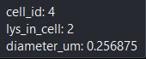
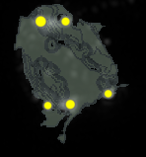
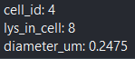
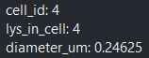
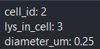
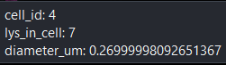
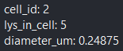
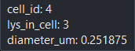
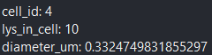
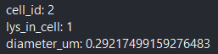
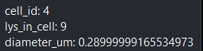
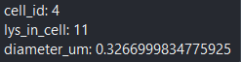
METRICS

Slide 8
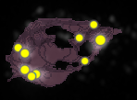
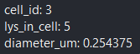
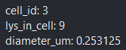
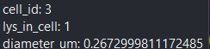
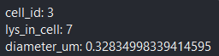
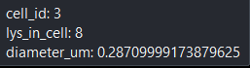
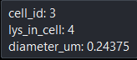
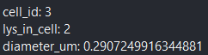
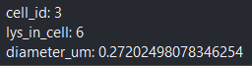
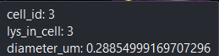
METRICS

Slide 9
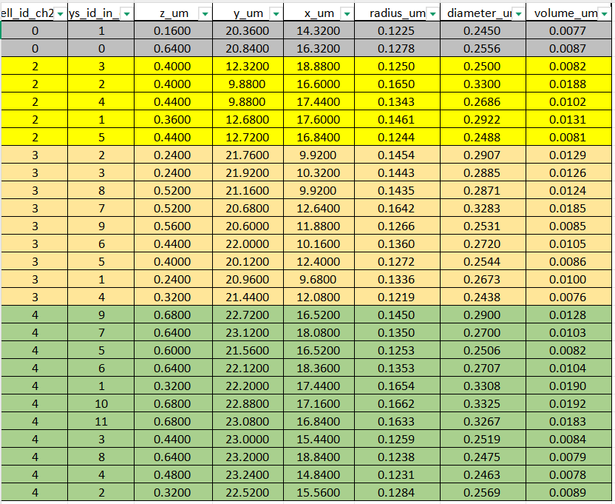
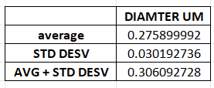
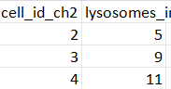
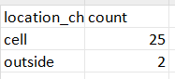
DATASET LYSOSOMES(ORDER FOR CELL ID)

Slide 10
Airy scan_40A_UAS-TMEM-HA_CB_0h_1_051222

Slide 11
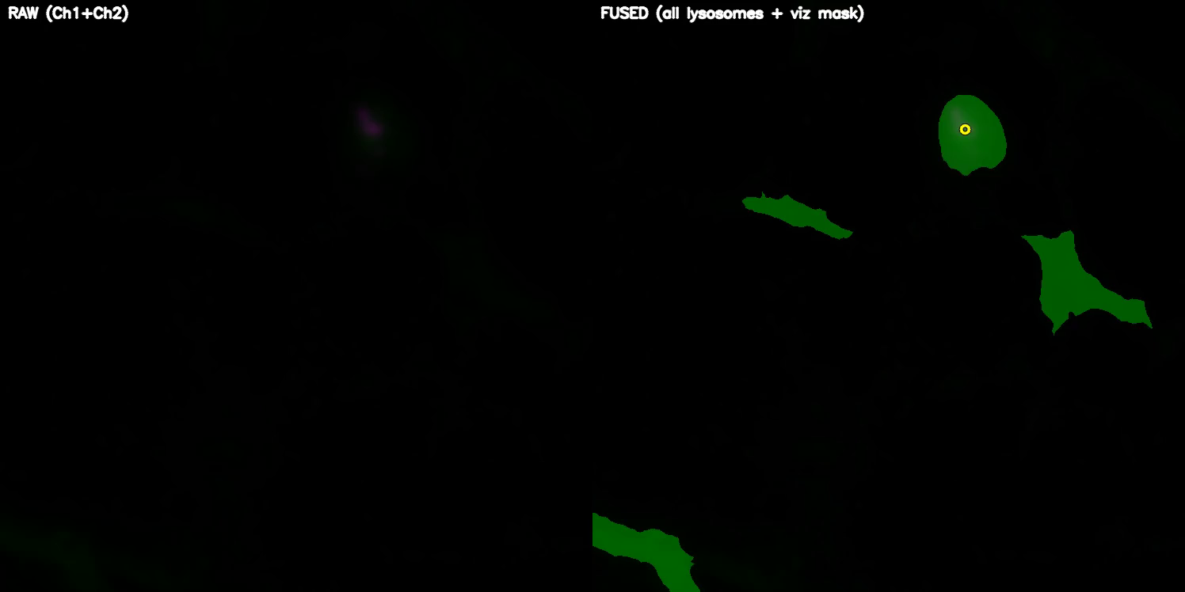
DETECTION VIDEO

Slide 12
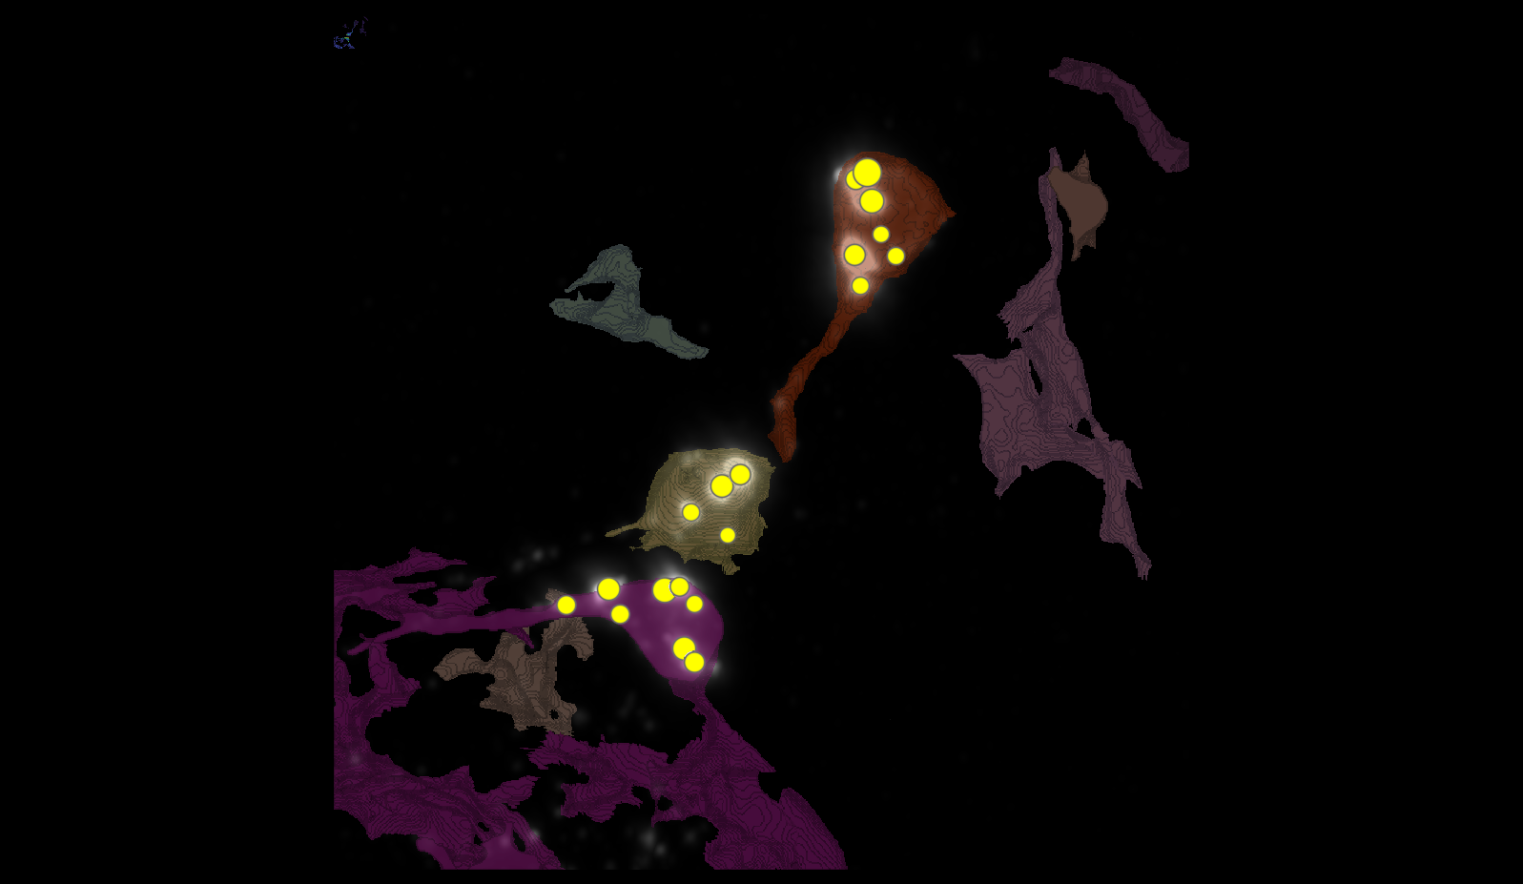
SEGMENTATION

Slide 13
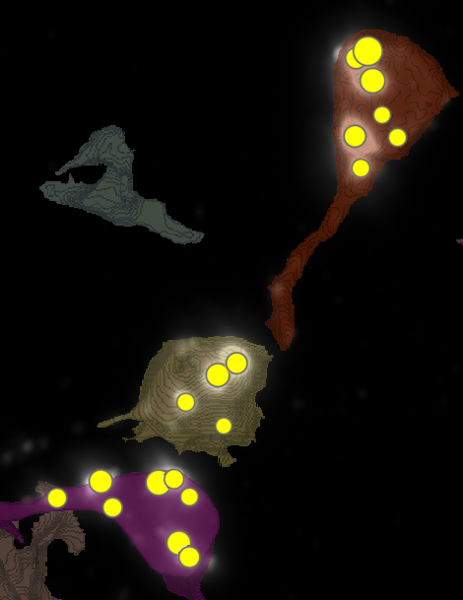
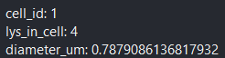
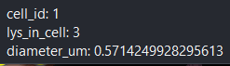
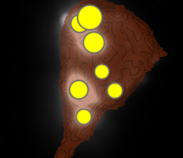
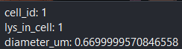
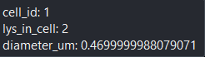
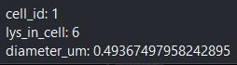
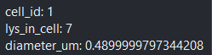
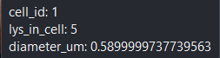
METRICS
1
6
4

Slide 14
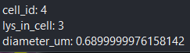
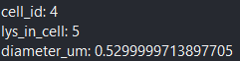
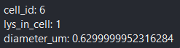











METRICS

Slide 15




DATASETS

Slide 16
Airy scan_40A_UAS-TMEM-HA_CB_0h_2_051222

Slide 17

DETECTION VIDEO

Slide 18

SEGMENTATION
1
4
2
3

Slide 19
















METRICS

Slide 20




DATASETS

Slide 21
Airy scan_40A_UAS-TMEM-HA_CB_4h_1_051222

Slide 22

DETECTION VIDEO

Slide 23

SEGMENTATION
4
5
2
3

Slide 24


























METRICS

Slide 25




DATASETS

Slide 26
Airy scan_40A_UAS-TMEM-HA_CB_4h_2_051222

Slide 27

DETECTION VIDEO

Slide 28

SEGMENTATION

Slide 29




























METRICS

Slide 30




DATASETS

Slide 32

TMEM-HA 6h CB airy_3_170722

Slide 33

TMEM-HA 6h CB airy_3_170722

Slide 34







































TMEM-HA 6h CB airy_3_170722

Slide 35






















TMEM-HA 6h CB airy_3_170722

Slide 36


























TMEM-HA 6h CB airy_3_170722

Slide 37





TMEM-HA 6h CB airy_3_170722

Slide 38

40A_UAS-TMEM192-3xHA x 40A 71G10 MARCM_around 12h - for quantification_4 Airy-CBs_300425

Slide 39

40A_UAS-TMEM192-3xHA x 40A 71G10 MARCM_around 12h - for quantification_4 Airy-CBs_300425
lys_id:2
lys_id:1
lys_id:3

Slide 40




40A_UAS-TMEM192-3xHA x 40A 71G10 MARCM_around 12h - for quantification_4 Airy-CBs_300425

Slide 41

40A_UAS-TMEM192-3xHA x 40A 71G10 MARCM_around 12h - for quantification_3 Airy-CBs_300425

Slide 42

40A_UAS-TMEM192-3xHA x 40A 71G10 MARCM_around 12h - for quantification_3 Airy-CBs_300425

Slide 43





















40A_UAS-TMEM192-3xHA x 40A 71G10 MARCM_around 12h - for quantification_3 Airy-CBs_300425

Slide 44




40A_UAS-TMEM192-3xHA x 40A 71G10 MARCM_around 12h - for quantification_3 Airy-CBs_300425

